Slide 1

Financial Forecasting
A Quick Start Guide
Philip Campbell

Slide 2

The ONE Big Question to Ask Yourself
Can the quick start approach to forecasting help me add value and make more money?

Slide 3
There are TWO REASONS to create and maintain a reliable financial forecast

Slide 4

We Can Help Create a Bigger and Brighter Future!

Slide 5


Slide 6
How to Make Work Fun (and Rewarding)
Think like an owner
Act like an owner
Become an owner

Slide 7
A Reliable Financial Forecast
Reliable – Unbiased, reality-based expectation of financial results that is designed for decision-making (not precision).
Financial Forecast - A full set of forward-looking financial statements that includes a 2-minute summary.

Slide 8
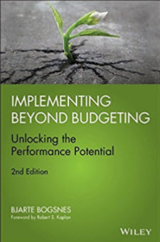
“Some would call ‘on course to hit a rock’ a bad forecast. Assuming it is true, it is a good forecast, even though it contains bad news.”
“I would much rather have good forecasts with bad news than a bad forecast with good news.”
- Bjarte Bogsnes,
Implementing Beyond Budgeting

Slide 9

“If there were only one thing that you could take away from this book it is this: Targets and forecasts are not the same.”
“A forecast is what we think will happen. A target is what we would like to happen.”
- Steve Player & Steve Morlidge,
Future Ready

Slide 10
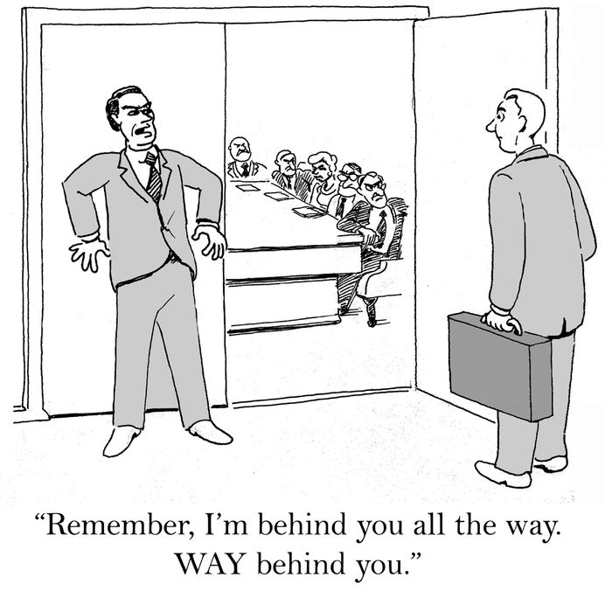
CEO
The Board
CFO

Slide 11
Benefits of a Reliable Financial Forecast
Create “permission” to provide bad news
Help you (and others) think like owners
Enhance your influence and credibility
Create a deeper understanding of the business model
Answer the BIG financial questions
Reduce the chance of error in the financial statements

Slide 12

Cool Restaurants, Inc.
A Fun Forecasting Example

Slide 13
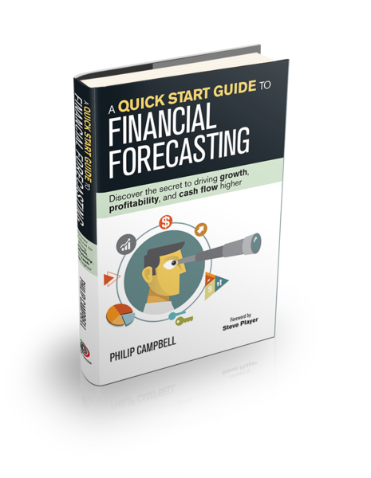
Quick Start Principles Based on My New Book
Release date is July 12th
Complimentary hardcover available after the session
Link to complimentary electronic version

Slide 14


Slide 15
Summary of Significant Accounting Policies
Accounting Estimates
The preparation of the consolidated financial statements in conformity with GAAP requires management to make estimates and assumptions that affect certain reported amounts of assets and liabilities and disclosure of contingent assets and liabilities at the date of the financial statements and the reported amounts of revenues and expenses for the period. Actual results could differ from estimates.

Slide 16

10 Rules for Creating a Forecast You Can Trust
It’s all about decision making, not precision
Think top-down, not bottom-up
Model a full set of financial statements
First look back, then look forward
Understand the high-level company strategy and expectations
Simplify, simplify, simplify
Create a repeatable process
Be conservative
Condense the results to a 2-minute summary
Start for your eyes only
© 2017 Philip Campbell

Slide 17


Slide 18
What two numbers can you multiply together to get revenues?
Number of customers × average ticket
Hours incurred × average billing rate
Gallons × average selling price

Slide 19

Top-Down, NOT Bottom-Up!

Slide 20
Question: How many people will you have to rely on to provide you with accurate estimates for your forecast?

Slide 21


Slide 22

First Look Back, Then Look Forward
No Blank Slates!

Slide 23
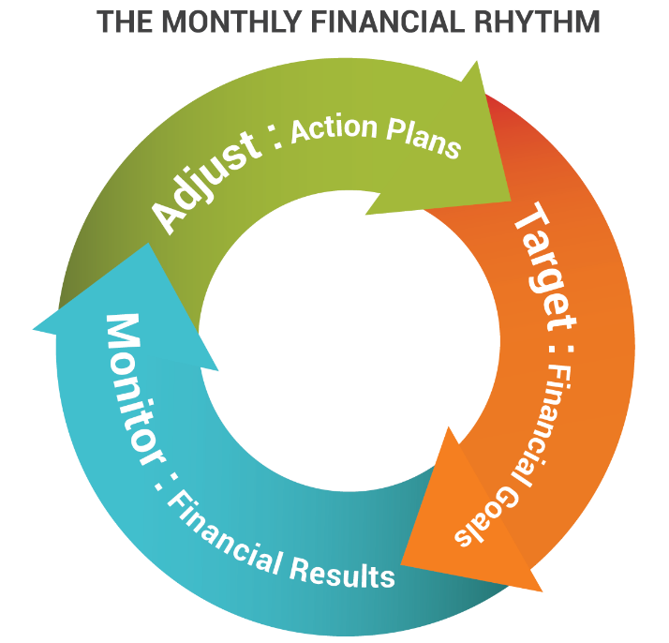
Create a Repeatable Process
Month 1
Month 2
Month 3…
Target
Monitor
Adjust
Target
Monitor
Adjust
Target
Monitor
Adjust

Slide 24

Condense the results to a
2-minute summary

Slide 25
“If you can’t explain it simply, you don’t understand it well enough.”
- Albert Einstein

Slide 26
The 2-Minute Summary
Memo to The CEO
Based on our growth plan for the coming year, we will need to raise $1.1 million to $1.3 million in cash by June 30. The primary driver of the need to raise cash is the plan for launching the new division in Texas. The expansion is forecast at $3.0 to $3.5 million driven primarily by the capital expenditures and first-year operating losses.

Slide 27


Slide 28
The Quick Start Essentials

Slide 29

Disconnect the Forecast…
… From Any Other Process

Slide 30
Dramatically Shorten the Forecast Period!

Slide 31

First Get it Wrong
Then, Get it Close

Slide 32


Slide 33
Precision is Your Enemy
The Trend is Your Friend

Slide 34
The 3-2-1 Quick Start to Forecasting
List 3 questions the forecast will answer.
2 numbers is the limit for each assumption.
Only 1 person creates the forecast.
3
2
1
© 2017 Philip Campbell

Slide 35
Cool Restaurants, Inc.
A Fun Forecasting Example

Slide 36
Cool Restaurants Summary (Last Year)
Founded in Austin, TX in 1982
Went public in July 2012
Had 32 restaurants when they went public
Now has 80 restaurants in 16 States at December 2016
Company owned restaurants (not franchised)

Slide 37
Cool Restaurants Summary (Last Year)
Revenues - $331 million
Average revenue per location - $4.6 million
Average ticket - $14.48
Square footage from 5,300 to 12,200
Seating for 225 to 400 customers
Open for lunch and dinner 7 days a week
Serve 316,000 customers per location per year

Slide 38
Growth Plan for 2017
Opening 11 – 14 restaurants each year
Expect capex to be $39.0 to $44.0 million
Capex per store is $1.9 to $2.5 million (net of tenant allowances of $0 to $1.0 million)
Capex includes $6.6 million for remodels and maintenance of existing stores and an expansion of the corporate office
Usually 7 stores under construction at a time

Slide 39
questions the forecast will answer
3
How much money will they make this quarter?
Will they need to borrow money to achieve their growth plans this quarter?
What will the 3 largest drivers of cash be this quarter?

Slide 40
Cash is The Real Bottom Line

Slide 41
Cash is The Real Bottom Line

Slide 42
Exercise #1
Forecast revenue and depreciation expense for next quarter

Slide 43
Forecasting Revenues?
Number of customers
Average ticket
Size of restaurant
Restaurant location
Same store sales
New restaurant sales
Rural vs. big city locations
New or old restaurant
Location demographics
Number of tables
Table size
Provide a take-out option or not
Provide a delivery option or not
Liquor vs. food sales
Lunch vs. dinner traffic

Slide 44
Store Count X Average Revenue

Slide 45
Store Count X Average Depr. Per Store

Slide 46
Balance Sheet and Cash Flow
Accounts receivable and inventory
Other assets
Capital expenditures
Accounts payable & accrued liabilities
Deferred rent, lease incentives, and taxes
Debt and/or equity

Slide 47
Category | Forecast Approach
Accounts receivable and inventory | Days Sales Outstanding (DSO)/Days Inventory Outstanding (DIO)
Other assets | % of revenue
Capital expenditures | One number
Accounts payable & accrued liabilities | Days Payables Outstanding (DPO)
Deferred rent, lease incentives, and taxes | % of revenue
Debt and/or equity | One number

Slide 48
Exercise #2
Forecast capital expenditures and accounts payable & accrued liabilities

Slide 49
Accounts Payable & Accrued Liabilities

Slide 50
Capital Expenditures

Slide 51
Review the Forecast
Drop the exercise assumptions in the XLS
Show the forecast results in the Cash Flow Focus Report view (in the XLS)
Answer the three questions (next slide)

Slide 52
questions the forecast will answer
3
How much money will they make this quarter?
Will they need to borrow money to achieve their growth plans this quarter?
What will the 3 largest drivers of cash be this quarter?

Slide 53
How Did We Do?
Actuals for the March Qtr vs forecast
And the company is…

Slide 54
The Benefits for YOU
Help you drive growth, profitability, and cash flow
Become more valuable
Makes work more fun and enjoyable
Reduces the risk of error in your financial statements

Slide 55
The ONE Big Question to Ask Yourself
Can the quick start approach to forecasting help me add value and make more money?

Slide 56
Questions?
Yes… Buts?

Slide 57
Your Next Step
List three benefits for YOU
Take a baby step with one month
Start for your eyes only

Slide 58
Downloads and Contact Information
financialrhythm.com/live-future-ready/
www.ILoveForecasting.com
Philip Campbell
  512.944.3520
  pcampbell@pdq.net

Slide 59
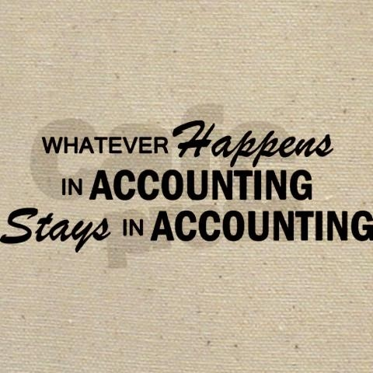

Slide 60


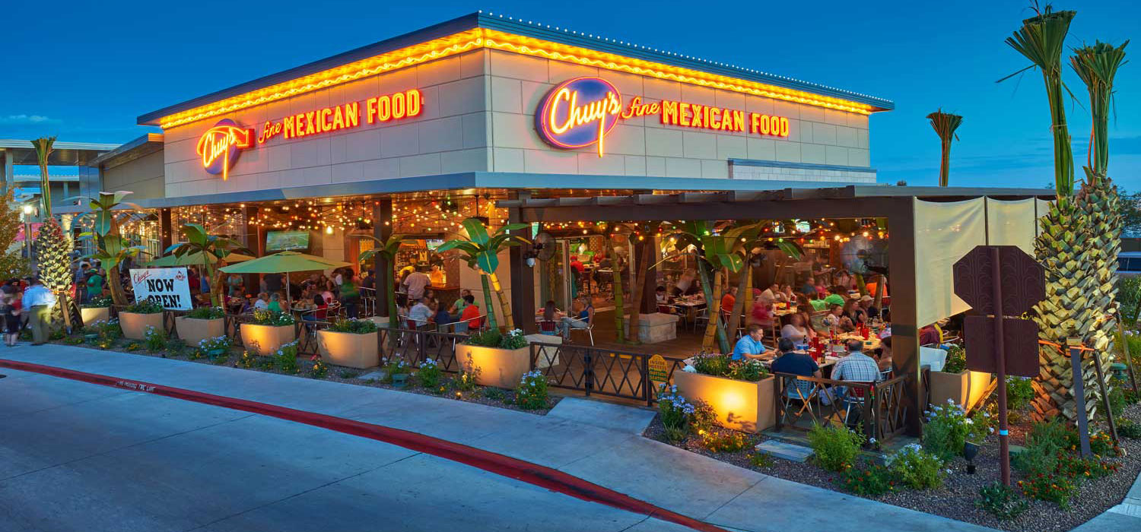
Chuy’s Holdings, Inc.

Slide 61
Actuals for the March 2017 Qtr

Slide 62


Slide 63
The Quick Start Essentials
Disconnect the forecast from any other process
Dramatically shorten the forecast period
First get it wrong… then get it close
Precision is your enemy… and the trend is your friend
© 2017 Philip Campbell

Slide 64

The Secret is to Simplify

Slide 65
Drive growth, profitability, and cash flow higher

